Slide 1



Slide 2

Comprehensive Digital Marketing Project Work SUBMITTED BY : 1) KEERTHI MIDUTHURI 2) JAHNAVI KARRI 3) UJJWAL PRAKASH KOSIREDDY 4) P.V.S.S.NIVEDITA 5) CHIKKAM SWETHAHAR
AMUL full form is Anand Milk Union Limited. It is a cooperative dairy enterprise headquartered in the small town of Anand in the Indian state of Gujarat. Amul is India’s leading manufacturer of milk and milk products. The organisation is credited with introducing India’s white revolution and is praised as a successful cooperative business model that has empowered village men and women. It has turned ordinary country women into mini-entrepreneurs.

Slide 3
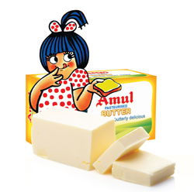
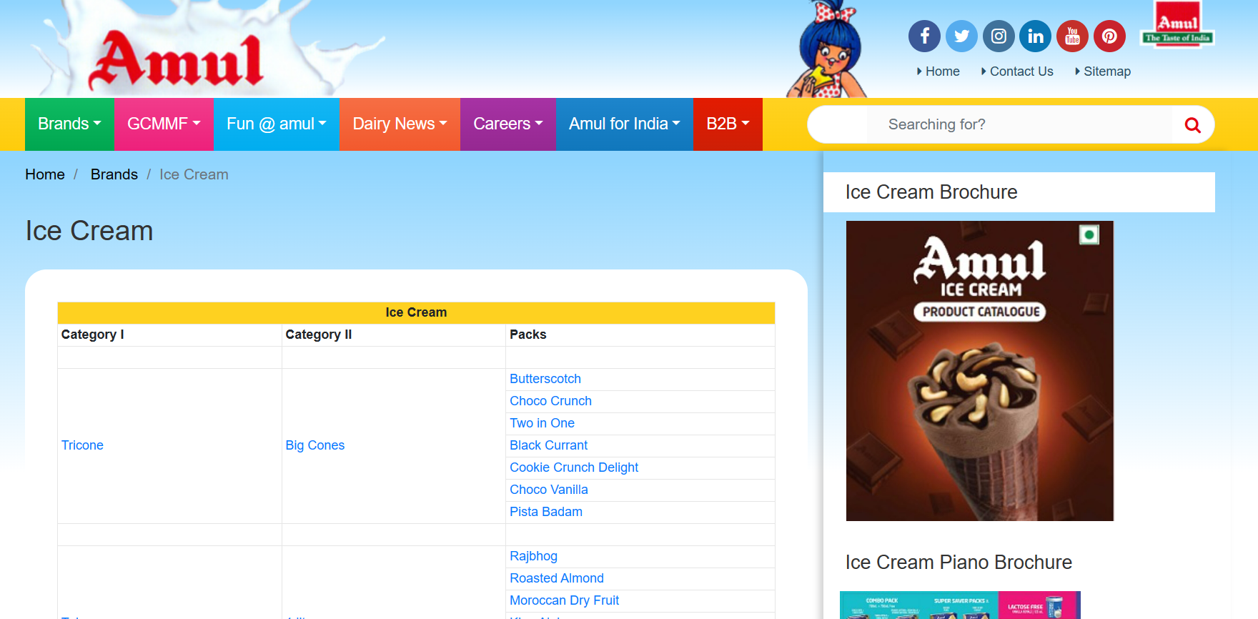

Research Brand Identity:
Logo :
Brand Colour : white background with a girl
Brand Messaging : Taste Of India
Mission/Values:
“Amul's vision is to provide mor and more satisfaction to the farmers, employees and distributers”
Mission • GCMMF endeavour to satisfy the taste and nutritional requirements of the customer of the world through excellence

Slide 4
Amul believes and thinks that good ethics and good business go together naturally to produce the best long-term results for all the investors and stakeholders. Amul gives the credit to the values which are based upon performance, quality, respect, integrity and responsibility, honesty, openness and courtesy marketing by the committed team.
USP:
Cooperative Model: Amul operates as a cooperative organization, which means it is owned and managed by the farmers themselves. The farmers are also the stakeholders and decision-makers of the cooperative, allowing them to have a significant say in the business's operations and profits.
Quality Products: Amul is renowned for producing high-quality dairy products. It maintains strict quality control measures at every stage of production, ensuring that consumers receive fresh and safe products.
Wide Product Range: Amul offers a diverse range of dairy products, including milk, butter, ghee, cheese, ice cream, yogurt, and other value-added products. This extensive product portfolio caters to various consumer preferences and needs.
IN SHORT :
USP : Wide variety of, All round sale
Communication : Celebrity Endorsement , Content memes ,
Lots of tutorials by experienced chefs. food products , Categorisation .

Slide 5
Analyze Brand Messaging:
Amul's brand messaging can be analyzed based on its key elements and the values it conveys to its target audience:
Quality and Trust: Amul's messaging consistently emphasizes the quality and trustworthiness of its dairy products. Through its tagline "The Taste of India" and various communications, Amul positions itself as a reliable brand that delivers products with consistent taste and safety.
Cooperative and Farmer Empowerment: Amul's unique cooperative model is a central theme in its brand messaging. By highlighting that it is owned and managed by farmers, the brand portrays a sense of community and empowerment, resonating with consumers who appreciate supporting local farmers and their livelihoods.
Accessibility: Amul's brand messaging communicates the idea that good quality dairy products should be accessible to all. By offering products at affordable prices, the brand appeals to a wide range of consumers across different socio-economic backgrounds.
Examine the brand's tagline
Amul's brand tagline is "The Taste of India." This tagline encapsulates Amul's commitment to delivering high-quality dairy products that resonate with the diverse tastes and preferences of consumers across India. It reinforces the brand's association with Indian flavors and culinary traditions, making it a trusted choice for consumers seeking authentic and delicious dairy products.

Slide 6
Part 1: Brand study, Competitor Analysis & Buyer’s/Audience’s Persona
Competitor Analysis:
Competitor 1:
Mother Dairy: Mother Dairy is another major dairy brand in India, established by the National Dairy Development Board (NDDB). It offers a wide range of dairy products, including milk, ice cream, butter, ghee, and more.
Competitor 2:
Nestlé: Nestlé is a global food and beverage company that has a significant presence in the Indian dairy market. It produces and markets various dairy products, such as milk, yogurt
Competitor 3:
Britannia: While Britannia is primarily known for its bakery products, it also competes with Amul in the dairy segment. Britannia offers a variety of dairy products like cheese, butter, and dairy-based beverages.

Slide 7



COMPETITORS ZONE
motherdairy.com
Nestlé: Good food, Good life | Nestlé India (nestle.in)
Home - News And Media (britannia.co.in)

Slide 8
Part 1: Brand study, Competitor Analysis & Buyer’s/Audience’s Persona
Buyer's/Audience's Persona:
Here are some key segments that make up Amul's buyer audience:
Everyday Consumers: Amul's primary audience consists of everyday consumers who purchase dairy products for their regular consumption. This includes individuals, families, and households who buy products like milk, butter, cheese, yogurt, and ice cream for their daily needs.
Health-Conscious Consumers: Amul appeals to health-conscious individuals who seek nutritious and high-quality dairy products. The brand offers a range of options, including low-fat and probiotic products, catering to health-conscious buyers.
Children and Youth: Amul's ice cream and flavored milk products are popular among children and young consumers. The brand's various ice cream flavors and affordable pricing make it a favorite treat for this audience.

Slide 9
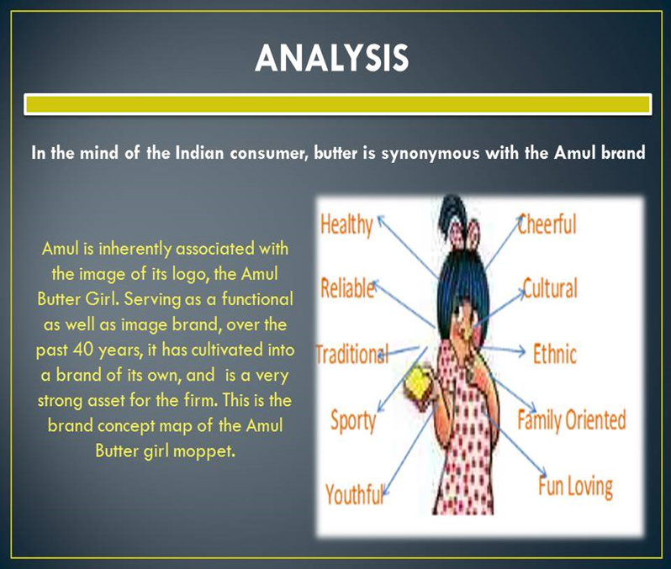
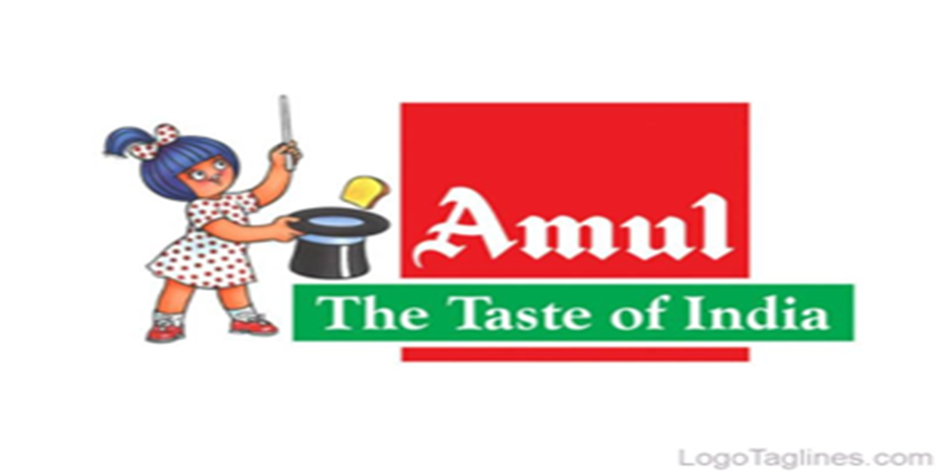

Slide 10
Part 2: SEO & Keyword Research
Site-level issues
WWW and non-WWW WWW and non-WWW work as separate websites.
Content Security Policy Defence against cross-site scripting attacks is not implemented
Strict Transport Security Redirect to HTTPS is not implemented in response header
Robots.txt Site has an invalid robots.txt file
Mobile PageSpeed Home page is rated 46 of 100 in Mobile PageSpeed Insights
The main purpose of an search engine optimization (SEO) audit is to identify strengths, weaknesses, and opportunities for improvement to enhance a website's visibility in search engine results and drive organic traffic.

Slide 11
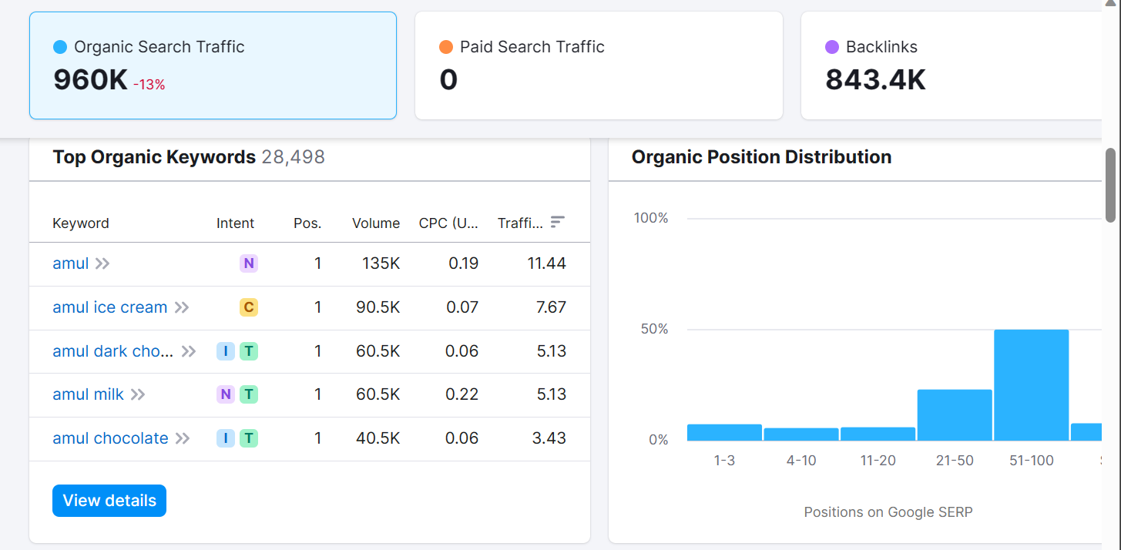

Slide 12
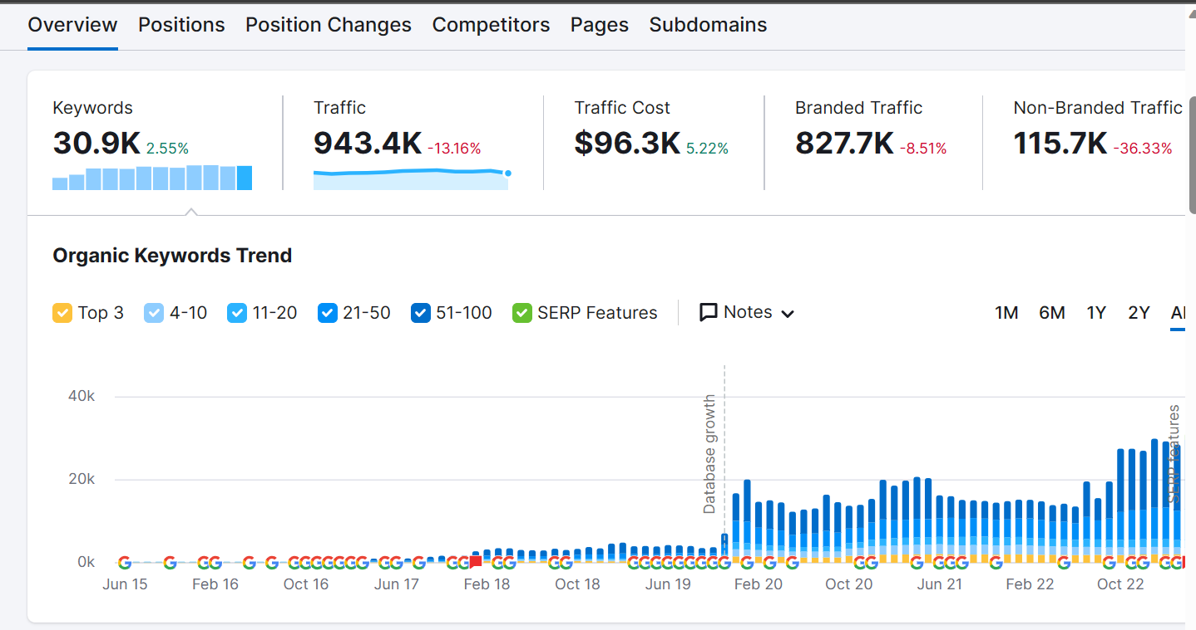
Keyword research

Slide 13
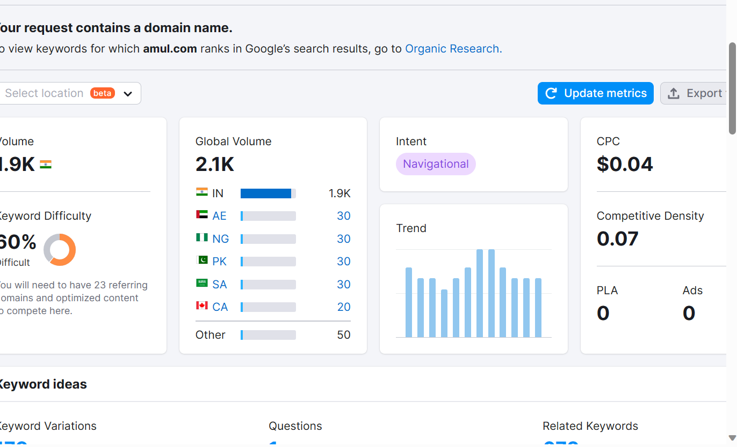
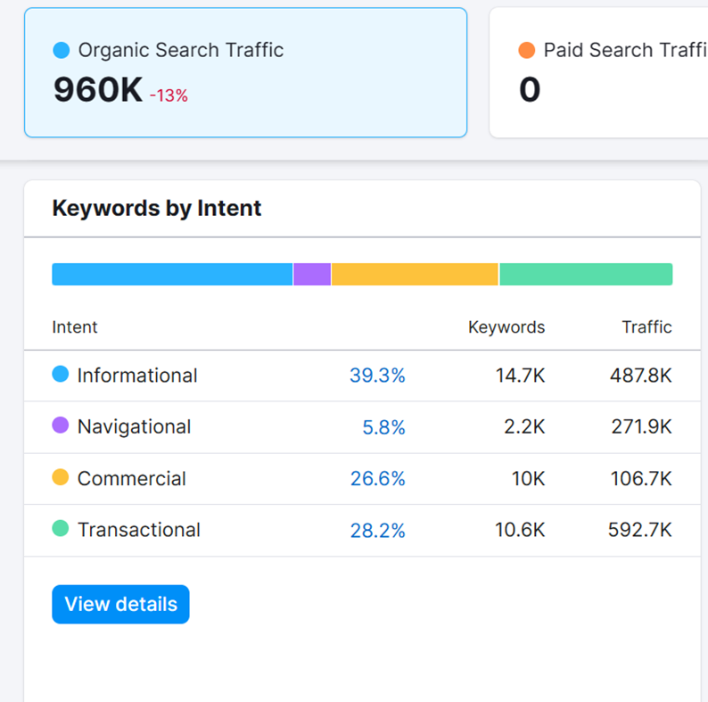

Slide 14
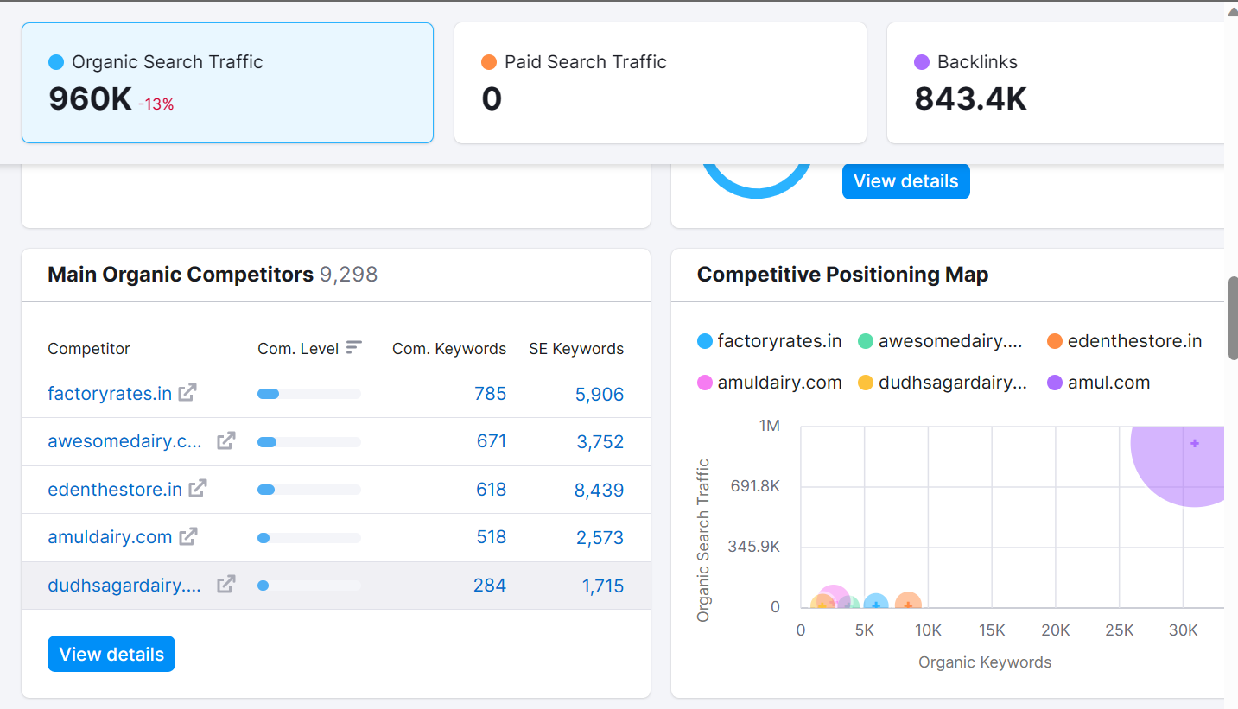
COMPETITORS KEYWORD RESEARCH

Slide 15
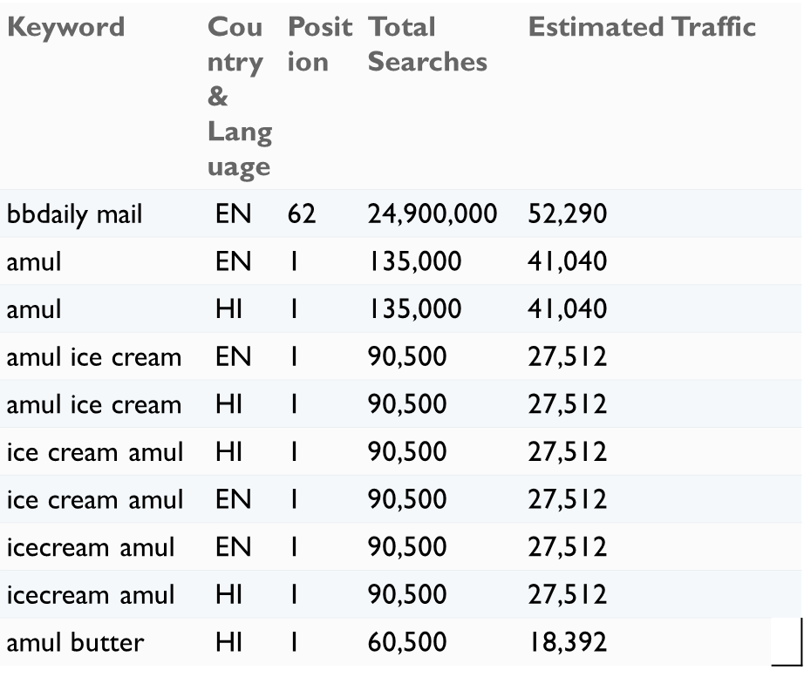
traffic on the website

Slide 16
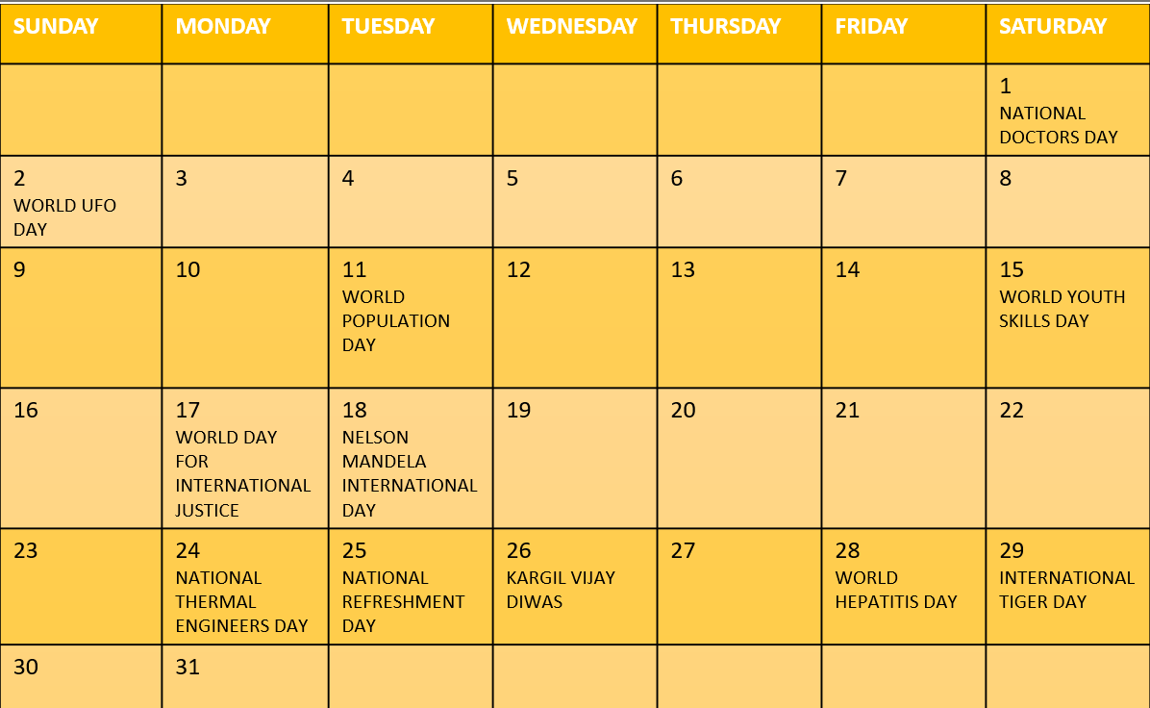

Slide 17
LET’S HAVE A INTERACTIVE QUIZZ
When was amul founded ?
a)1981 b)1946 c)1953 d)1986
What is the first product of amul?
a )milk powder b)ice cream c)cheese d) chocolate
Who is the CEO of amul ?
a)alisha chauhan b)nadia chauhan c)tarun bhatia d) schauna
Where is the headquarters of Amul?
a)mumbai b)hyderabad c)kolkata d)gujarat
What is the new product of amul?
a)honey b)butter c)shakes d)drinks
How many flavours available in amul smoothies ?
a)2 b)4 c)6 d)5
Which is not amul product?
a)ice cream b)magnum c)milk d)cookies

Slide 18
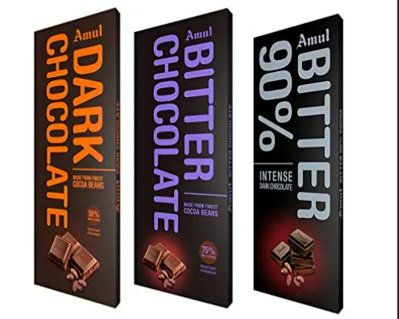
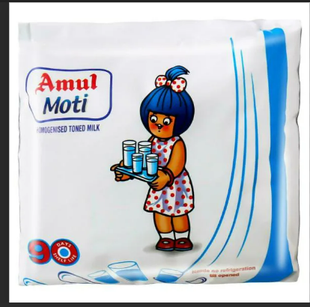
Blog PAGE
Amul - "The champion's choice"July 20, 2023Amul –
"The champion's choice" Feature sports stars and athletes fueling their performance with Amul products, emphasizing the importance of nutrition and taste for a winning edge. Here are some products:
1.milk - The nutritional profile of Amul milk is identical to that of fresh milk extract from the diaries, which means that it is an excellent source f vitamins A and D, calcium, and protein
.2.dark chocolate - Amul dark chocolate with 99% cocoa is considered the best and the healthiest chocolate bar for its numerous benefits. These foods contain carbohydrate and protein for recovery, plus other nutrients to help keep a athlete's diet healthy and well balanced.

Slide 19
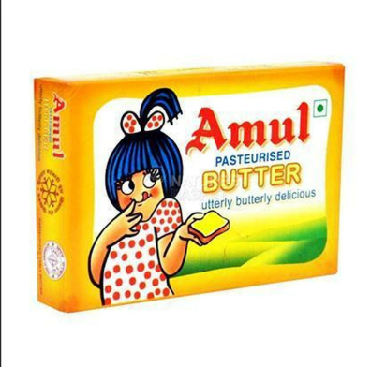
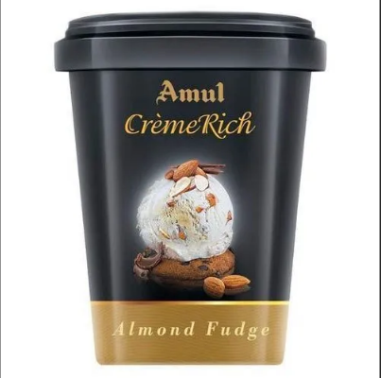
Blog [continuation]
3.butter - Butter is also high in conjugated linoleic acid (CLA), a fatty acid that helps your muscles repair after strenuous exercise.
4.ice Cream - once the components of the ice cream start to break down, the cooling effect is diminished. The milk fat and sugar produce heat in the body and when the temperature outside is high, this extra heat will not keep us cool but instead have the opposite effect.”

Slide 20
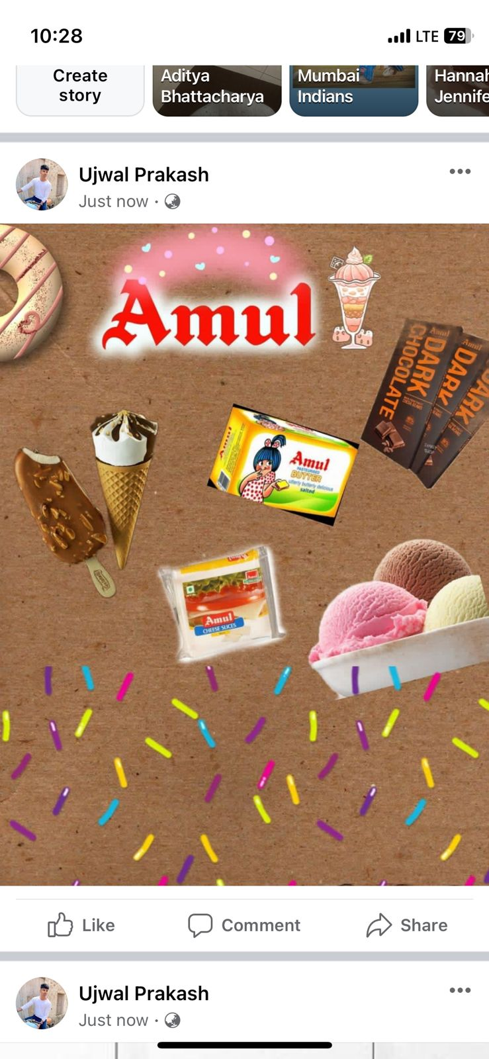
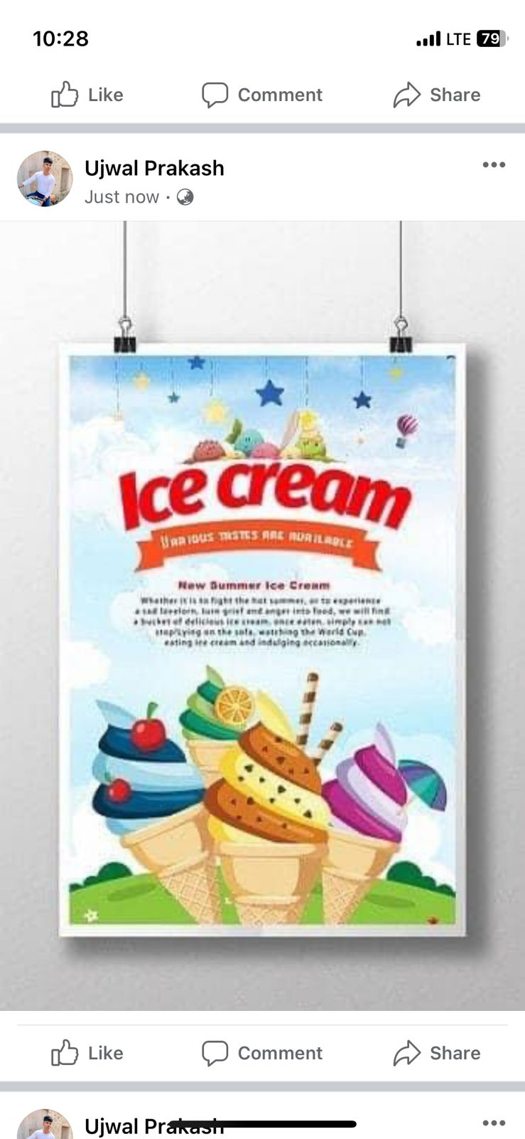
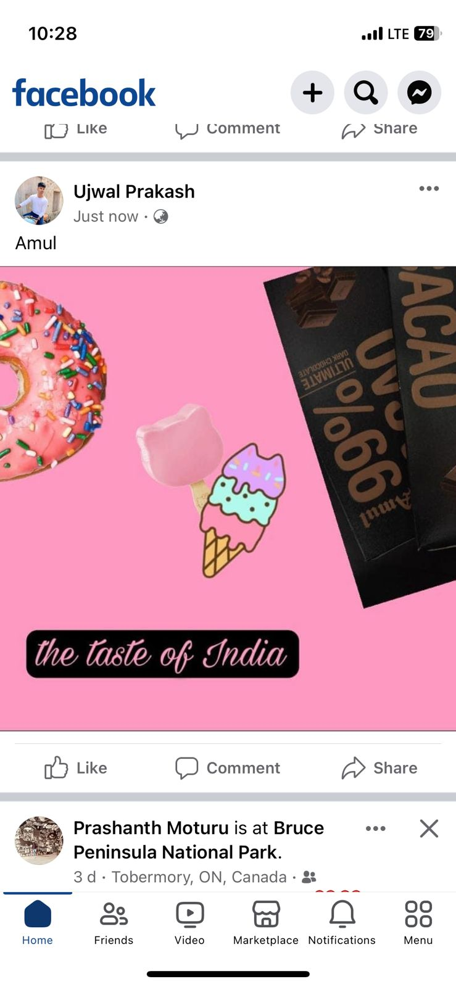
FB PROMOTIONS

Slide 21
Part 3: Content Ideas and Marketing Strategies
Challenges:
Creativity and Originality: Generating fresh and original content ideas can be a challenge, especially when trying to stand out in a crowded digital landscape. It's essential to avoid regurgitating the same ideas and strive for uniqueness.
Alignment with Brand Values: Ensuring that content ideas and marketing strategies align with the brand's core values and mission can be difficult. Straying from these principles may lead to confusion among the audience.
Market Saturation: Many industries have become oversaturated with content, making it challenging to capture the audience's attention and differentiate from competitors.

Slide 22
Part 3: Content Ideas and Marketing Strategies
Content Distribution: Even with fantastic content ideas, getting the message to the target audience can be tough due to issues like algorithm changes on social media platforms and email deliverability challenges.
Budget Constraints: Limited budgets can hinder the execution of ambitious marketing strategies, leading to difficulties in reaching a broader audience.
Data-driven Decision Making: Some marketers may struggle to interpret data effectively and make data-driven decisions, leading to inefficiencies in their marketing efforts.

Slide 23
Part 3: Content Ideas and Marketing Strategies
Lessons Learned:
Customer-Centric Approach: Putting the audience's needs and preferences at the forefront is essential. Understanding your target audience deeply helps in generating relevant and engaging content ideas and marketing strategies.
Consistency Across Platforms: Maintaining consistency in brand messaging and visuals across various platforms fosters brand recognition and trust.
Experimentation and Iteration: Don't be afraid to try new content ideas and marketing strategies. Learn from both successes and failures and iterate on what works best.
Storytelling: Embrace the power of storytelling to connect with your audience emotionally. People often remember stories better than plain information.

Slide 24
Part 3: Content Ideas and Marketing Strategies
Personalization: Tailoring content and marketing messages to individual users based on their preferences and behaviors can significantly improve engagement.
Data Analysis and Insights: Invest in analyzing data from various sources to gain valuable insights into your audience, content performance, and marketing effectiveness. This data can inform future decisions.
Leverage Influencers and User-Generated Content: Collaborating with influencers and encouraging user-generated content can help expand reach and credibility.
Strategic Partnerships: Explore partnerships with other brands or businesses that share similar target audiences to broaden your reach.
Embrace Change: Stay agile and adaptable in the face of a constantly changing digital landscape. Be open to adjusting your content ideas and marketing strategies as needed.

Slide 25
ADVERTISISNG GOALS
Advertising Goals for AMUL :
Market Expansion :
The goal is to expand AMUL’s market presence by reaching new demographics and geographic regions. This could involve targeting new customer segments, introducing products tailored to specific regions, or entering international markets.
Product Awareness:
Increase awareness about specific amuls products, such as amul dark chocolate and its new varients and also the wide range of varieties in ice creams .
Social Media Engagement:
Boost engagement on amuls social media platforms by encouraging more likes, shares, comments, and interactions with the brand's content. This goal aims to build a strong community of loyal followers and brand advocates.

Slide 26
Competitive Differentiation:
Emphasize Amuls unique selling points and differentiators, setting the brand apart from competitors in the crowded beverage market. The goal is to communicate why Amuls products stand out and offer better value to consumers.
Seasonal Promotions:
Launch targeted advertising campaigns around specific seasons or festivals, aligning amuls products with the preferences and needs of consumers during those periods.
Brand Loyalty and Advocacy:
Foster brand loyalty among existing customers and turn them into brand advocates. Encourage repeat purchases and word-of-mouth referrals through loyalty programs, exclusive offers, and customer appreciation initiatives.

Slide 27
Audience Targeting
Amul’s target audience comprises diverse demographics, interests, and behaviors, reflecting the wide appeal of their products. The primary target audience can be defined as follows:
Demographics:
Age: The main target age group falls between 05 to 70 years, capturing both young adults and millennials and old who are adventurous, health-conscious, and open to trying new products.
Gender: Amul’s products appeal to both male and female consumers, with a focus on gender-neutral marketing to be inclusive.
Location: The target audience includes urban and semi-urban areas with a focus on regions where Amul has a strong market presence.
Interests and Behavior:
Health and Wellness Enthusiasts: Individuals who prioritize health and are interested in flavouful ,natural and nutritious options. They seek products that align with their active lifestyle.

Slide 28
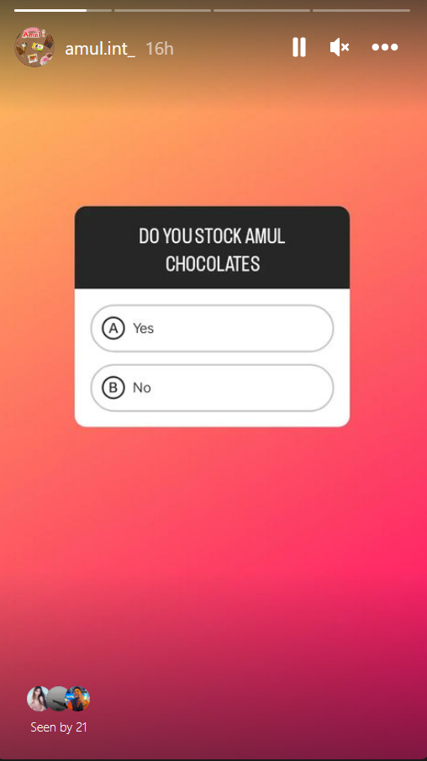
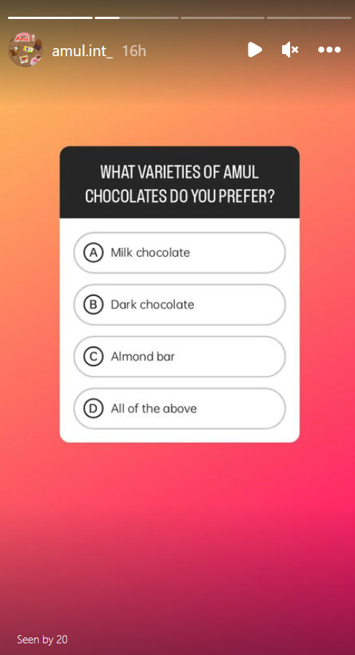
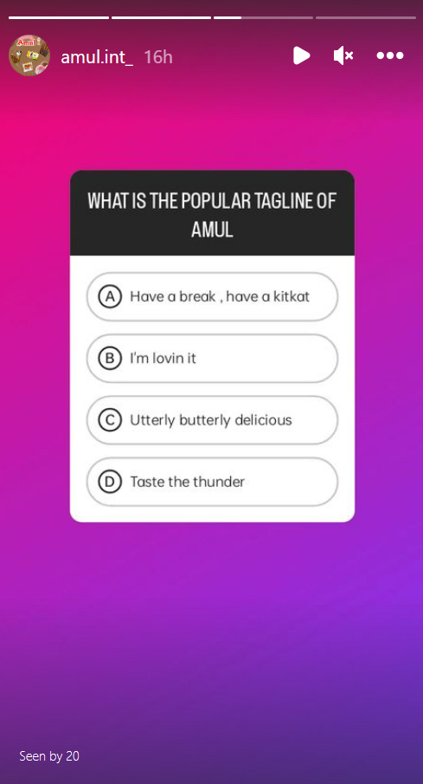
Part 4: Content Creation and Curation (Post creations, Designs/Video Editing, Ad Campaigns over Social Media and Email Ideation and Creation)
Instagram Story

Slide 29


Part 4: Content Creation and Curation (Post creations, Designs/Video Editing, Ad Campaigns over Social Media and Email Ideation and Creation)
POST

Slide 30

Part 4: Content Creation and Curation (Post creations, Designs/Video Editing, Ad Campaigns over Social Media and Email Ideation and Creation)

Slide 31

Part 4: Content Creation and Curation (Post creations, Designs/Video Editing, Ad Campaigns over Social Media and Email Ideation and Creation)
Designs/Video Editing

Slide 32
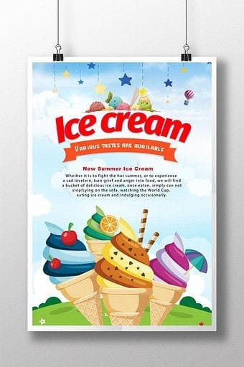
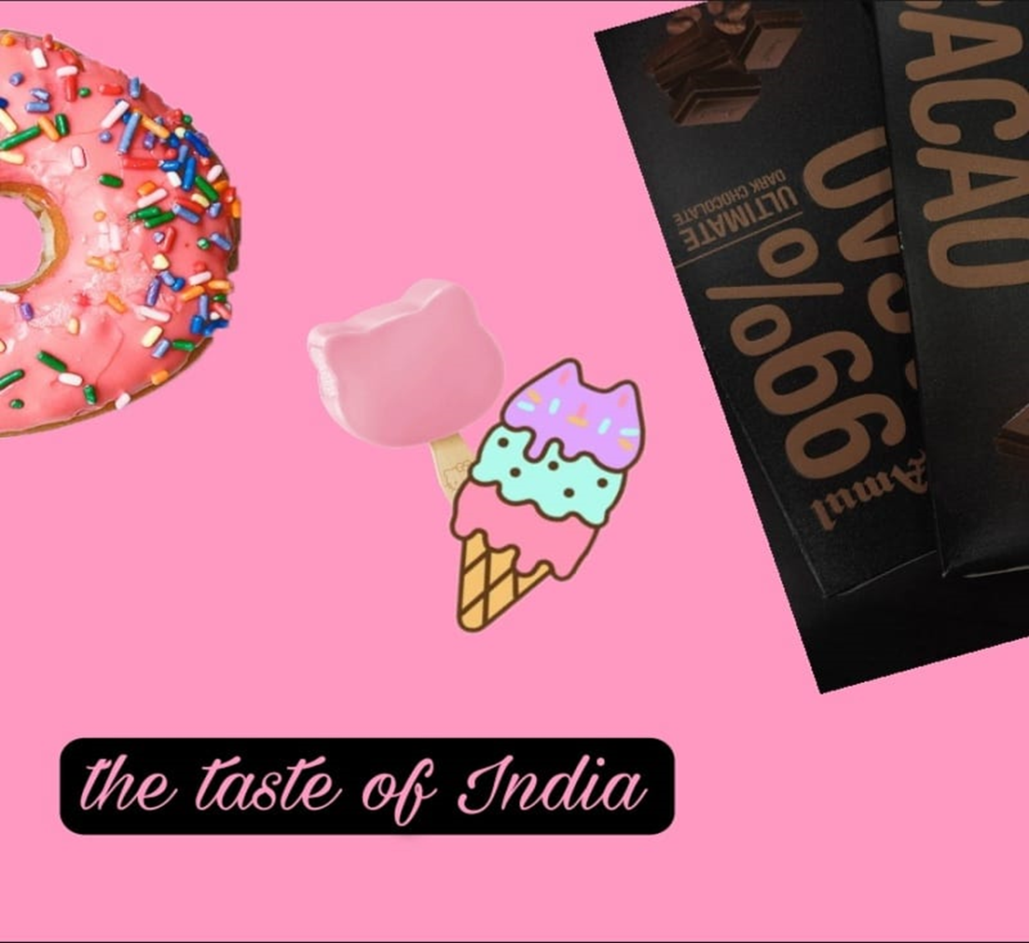

Designs/Video Editing

Slide 33
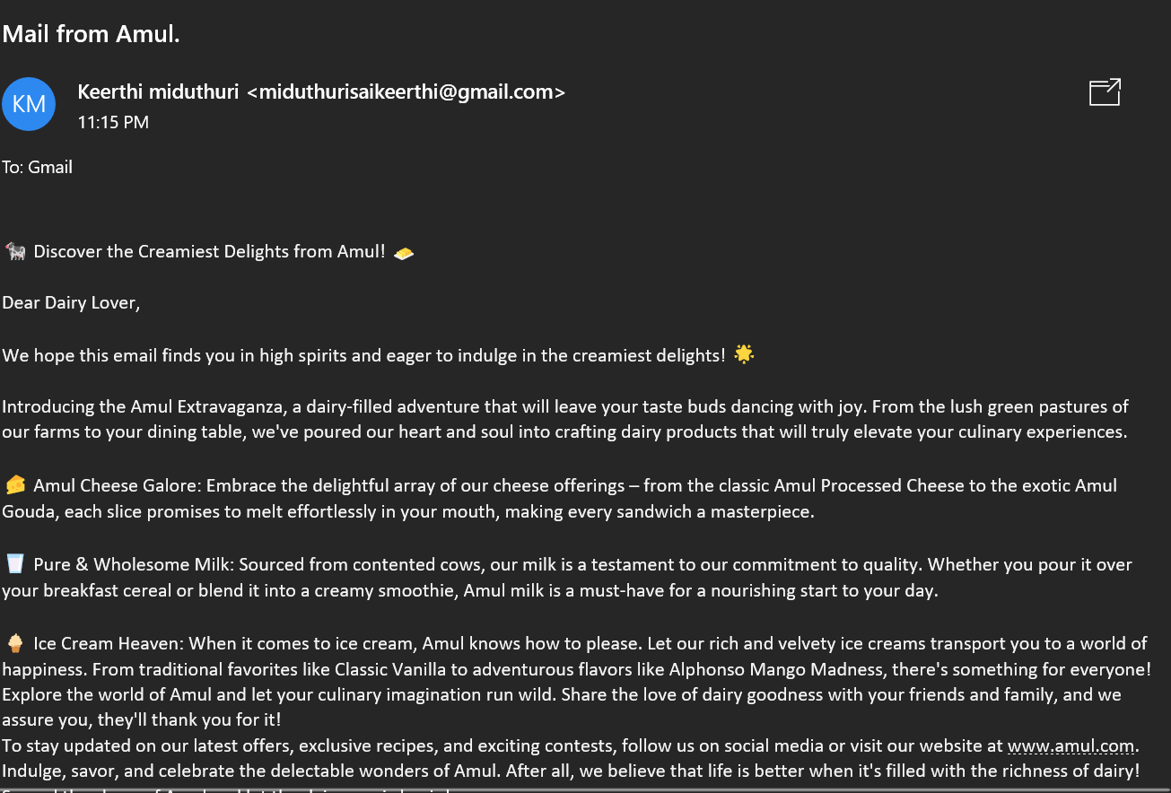
E m a I l a d c a m p a I g n - 1
Encouraging Call-to-Action
Strategic placement of clear and compelling call-to-action (CTA) buttons in email campaigns prompts leads to take specific actions, such as signing up for newsletters or exploring product offerings.
Measuring and Optimization
Email marketing provides valuable data on campaign performance, including open rates, click-through rates, and conversion rates. This data-driven approach enables Amul to optimize future campaigns for better results.
Brand Building and Trust
Consistent and relevant email communication helps build brand trust and credibility, making potential leads more inclined to engage with Amul .
Moving Leads Down the Sales Funnel
Email campaigns play a crucial role in guiding leads through the sales funnel, from awareness to consideration and eventually conversion.

Slide 34
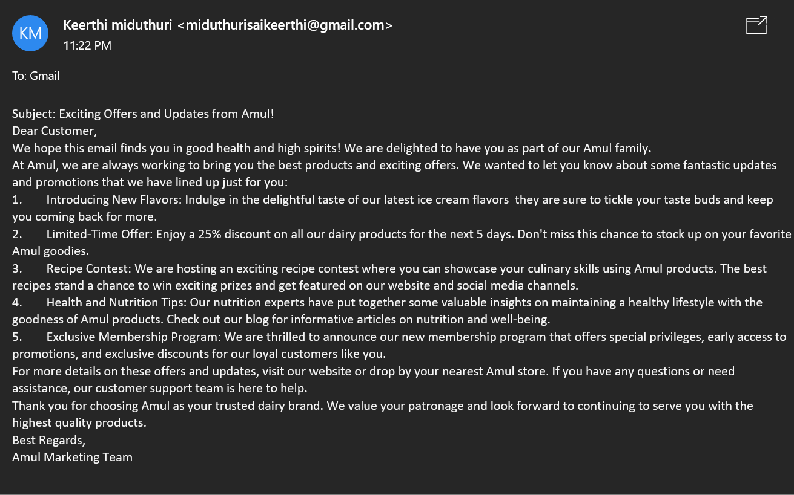
Email Ad Campaign 2
In conclusion, email campaigns are an
indispensable tool for Amul’s to increase
brand awareness, connect with consumers on
a personal level, and drive engagement and
conversions. By leveraging email marketing
strategically, Amul’s can amplify its brand
message, reach a wider audience, and establish
itself as a trusted and preferred choice for
natural strength and flavour.

Slide 35
Part 4: Content Creation and Curation (Post creations, Designs/Video Editing, Ad Campaigns over Social Media and Email Ideation and Creation)
CHALLENGES FACED WHILE CONTENT CREATIONS
Understanding the Audience: One of the significant challenges in content creation is understanding the target audience. Without a clear grasp of who the content is meant for, it becomes challenging to deliver relevant and engaging material. Creators must invest time in research to understand their audience's preferences, needs, and pain points.
Keeping Up with Trends: The digital landscape is constantly evolving, with new platforms, formats, and trends emerging regularly. Staying up-to-date with these changes is crucial for content creators to remain relevant and competitive. However, it can be overwhelming to keep pace with the rapid rate of change.
Time Management: Content creation can be time-consuming, especially when it involves research, planning, production, and editing

Slide 36
Part 4: Content Creation and Curation (Post creations, Designs/Video Editing, Ad Campaigns over Social Media and Email Ideation and Creation
LESSONS LEARNED WHILE CONTENT CREATION
Know Your Audience: Understanding your target audience's preferences and needs is the foundation of successful content creation and curation.
Consistency is Key: Regularly producing valuable content is vital for building and maintaining an audience.
Balance Innovation and Proven Methods: Strive to be creative and innovative while also considering what has worked well in the past.
Adapt to Changes: Embrace and adapt to the constantly evolving digital landscape to remain relevant.

Slide 37


